Slide 1
PREDICTING THE LIKELIHOODOF E-SIGNING THE LOAN BASED ON FINANCIAL HISTORY
Presented by :- Jaskaran Singh
Under Guidance of : Md. Farmanul Haque

Slide 2
Model and Optimization of model
Machine Learning works on the basis of some models. Models can either predict a value or classify an entity.
Namely, we will be using: Logistic Regression, SVM, decision tree, random forest
OPTIMIZATION: it is for enhancing of accuracy of a model.
Grid search
K-fold validation

Slide 3
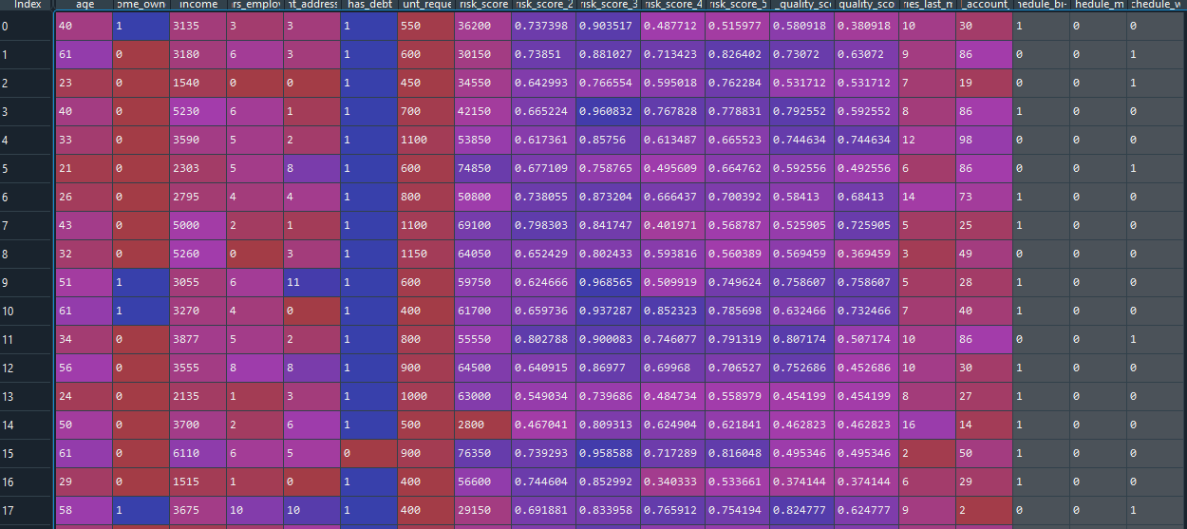
Dataset

Slide 4
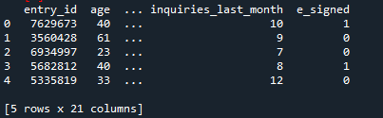
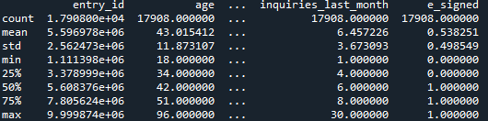
DETAILS ABOUT THE DATA SET
dataset.head() - displays first 5 rows of data, unless a number is specified in parameters.
dataset.describe() - views some basic statistical details like percentile, mean, std etc. of a data frame.

Slide 5
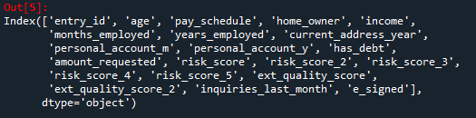
DETAILS ABOUT THE DATA SET
dataset.column – display all the columns present in the dataset

Slide 6
DROPPING THE UNNECESSARY COLUMNS FROM THE DATASET
The columns not adding much value to our project are dropped
from the data set using drop() function.
entry_id
pay_schedule
e_signed
Dropping these column further helps in improving our model and
training time

Slide 7
Data Visualization
Data visualization is the graphical representation of information and data. By using visual elements like charts, graphs, and maps, data visualization tools provide an accessible way to see and understand trends, outliers, and patterns in data.
In the world of Big Data, data visualization tools and technologies are essential to analyze massive amounts of information and make data-driven decisions.

Slide 8
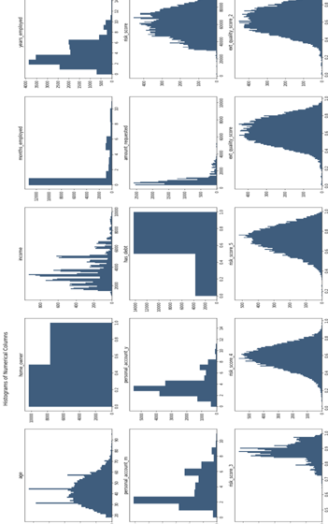
Histograms
Histograms are a special form of bar chart where the data represent continuous rather than discrete categories
In a bar chart the length of the bar indicates the size of the category, but in a histogram it is the area of the bar that is proportional to the size of the category.

Slide 9
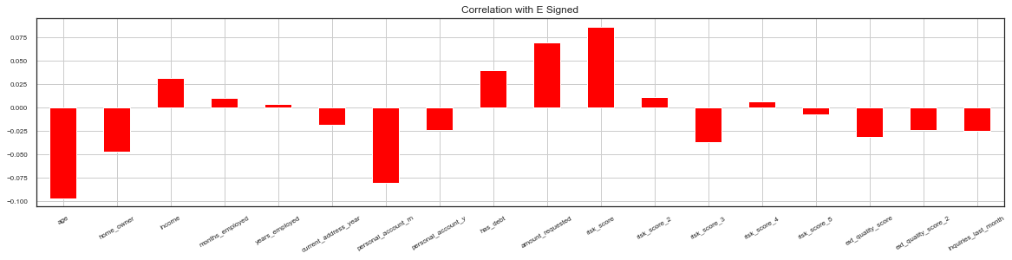
Correlation with responsive variable

Slide 10
Correlation with responsive variable
To show how strongly each feature affects e-signing.
X-axis contains all the feature.
How strongly their correlation is with, whether or not customer will apply for loan.
y-axis represent the degree of correlation.
In this correlation graph
The upper part represent positive(+ve).
The lower part represents negative(-ve).

Slide 11
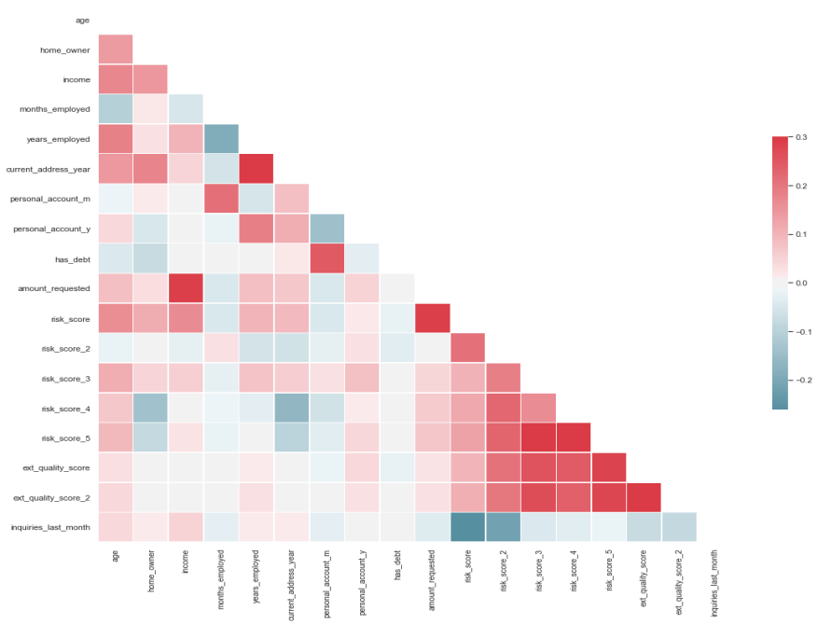
Heatmap
A heatmap is a graphical representation where individual values of a matrix are represented as colors.
A heatmap is very useful in visualizing the concentration of values between two dimensions of a matrix.
2D representation of information with the help of colors.
Help the user visualize simple or complex
Information.
In the preceding code, we used the pcolor()
fuction to create the heatmap colors.
Darker color represent strong correlation.
Lighter color represent weak correlation

Slide 12

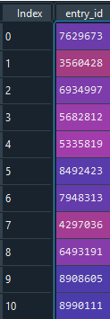
CLEANING OUT FEATURES
A new dataset has been formed using EDA. Some columns and rows are removed :
Taking the column entry_id and preserve or store it in the user .

Slide 13
We delete the 'personal_account_m‘ and 'personal_account_y‘ from the dataset and compute them under the same column named personal_account_y .
We further go on with One Hot Encoding to deal with the categorical values in our data set.
To prevent the dummy variable trap we delete any one of the column produced by One Hot Encoding .

Slide 14
SPLITTING TRAIN SET AND TEST SET
Divide the dataset into train and test set because of large data, so that we can train the model and test it. Use train_test_split() function .
Split data into training and testing (80/20 is indeed a good starting point).
Random is set to ‘0’ because we don’t want a random number to be generated.

Slide 15
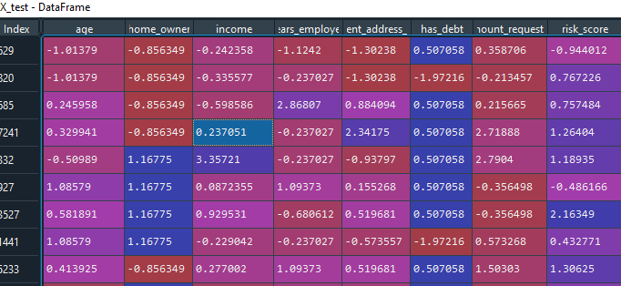
FEATURE SCALING
Feature scaling in machine learning is one of the most critical steps during the pre-processing of data before creating a machine learning model. Scaling can make a difference between a weak machine learning model and a better one.
Feature scaling is used as to scale down (normalize) a large amount of data

Slide 16
MODEL SELECTION

Slide 17
Testing the model
We use various functions to test our model on how much time it is taking to train, how accurately it can predict the outcomes on new data. For this we use various functions that are :
accuracy_score( ) - In multilable classification, this function computes subset.
precision_score( ) - Compute the precision. The precision is the ratio tp / (tp + fp) where tp is the number of true positives and fp the number of false positives.
recall_score( ) - Compute the recall. The recall is the ratio tp / (tp + fn) where tp is the number of true positives and fn the number of false negatives. Smaller the recall better is our model.
f1_score( ) - Compute the F1 score, also known as balanced F-score or F-measure. The F1 score can be interpreted as a weighted average of the precision and recall, where an F1 score reaches its best value at 1 and worst score at 0. The relative contribution of precision and recall to the F1 score are equal. The formula for the F1 score is: F1 = 2 * (precision * recall) / (precision + recall)

Slide 18

Logistic Regression
Logistic regression is a supervised learning classification algorithm used to predict the probability of a target variable. The nature of target or dependent variable is dichotomous, which means there would be only two possible classes.
In simple words, the dependent variable is binary in nature having data coded as either 1 (stands for success/yes) or 0 (stands for failure/no).
It is one of the simplest ML algorithms that can be used for various classification problems such as spam detection, Diabetes prediction, cancer detection etc.

Slide 19

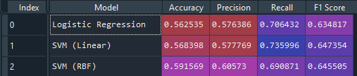
SVM – Support Vector Machine
“Support Vector Machine” (SVM) is a supervised machine learning algorithm which can be used for both classification or regression challenges. However, it is mostly used in classification problems. In the SVM algorithm, we plot each data item as a point in n-dimensional space (where n is number of features you have) with the value of each feature being the value of a particular coordinate. Then, we perform classification by finding the hyper-plane that differentiates the two classes very well.
It is of 2 types:
1: SVM linear
2: SVM Rbf

Slide 20
Decision tree
Decision tree algorithm falls under the category of supervised learning. They can be used to solve both regression and classification problems.
Decision tree uses the tree representation to solve the problem in which each leaf node corresponds to a class label and attributes are represented on the internal node of the tree.
We can represent any boolean function on discrete attributes using the decision tree.

Slide 21
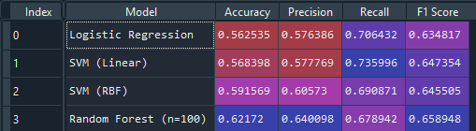
Random Forest
Random Forest is a popular machine learning algorithm that belongs to the supervised learning technique. It can be used for both Classification and Regression problems in ML.
It is based on the concept of ensemble learning, which is a process of combining multiple classifiers to solve a complex problem and to improve the performance of the model.
As the name suggests Random Forest is a classifier that contains a number of decision trees on various subsets of the given dataset and takes the average to improve the predictive accuracy of that dataset."

Slide 22
Model Optimization

Slide 23

Optimization of the Model
We have found the best model to be Random Forest, with an accuracy of approximately 62.59%
We have found that the model can be further optimized to give an improved accuracy so we have relied on the following methods:
K-Fold Cross Validation
Grid Search Cross Validation

Slide 24
K-Fold Cross Validation
K-Fold Cross Validation is a method of enhancing accuracy of a machine learning model.
It involves the dividing of a given data set into K number of groups called “folds”.
K iterations are performed, where each fold starting from 1 is selected as the testing set while the remaining are used to train the model.
This occurs until the Kth Fold is reached.
We have used a 10 fold K-Fold Cross Validator for our Random Forest classifying model.

Slide 25
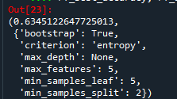
Grid Search Cross Validation
Hyperparameters are those parameters that we pass to the Machine Learning Model. Such as, the kernel used for SVM.
Grid Search algorithm runs an exhaustive search through the data set to determine the best hyperparameters.
Taking some randomly selected values for parameters, we have decided to utilize Grid Search on our model.
Round 1 results:

Slide 26
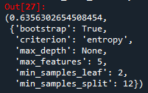
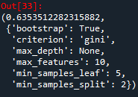
The best parameters obtained from the first Grid Search were fed into the parameters for the second Grid Search for the best results.
Round 2 results:
The result we get using hperparameters of 2nd round
Similarly result of Round 3 are used to give suitable parameters for round 4

Slide 27
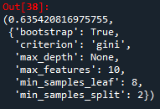

Round 4 results:
The result we get using hyperparameters of 4th round
So, after K-Fold Cross Validation and 4 Grid Searches, we are finally left with an accuracy of approximately 63.06% which is better than our initial accuracy of 62.59%

Slide 28
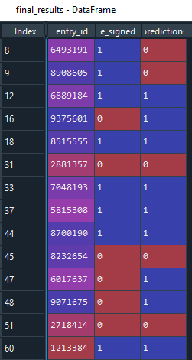
Results
Here is a small portion of our final results

Slide 29
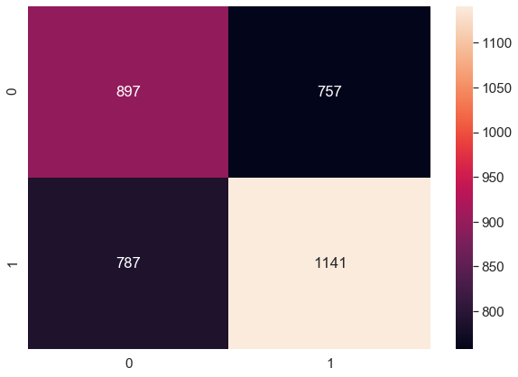
Conclusion
After optimzation has occured, this is theconfusion matrix we obtain.
True Positive predictions are- 879
True Negative predictions are-757
False Positive predictions are-787
False Negative predictions are-1141
Total correct predictions are-2038
Total incorrect predictions are-1544
Fatal errors -787

